Slide 1
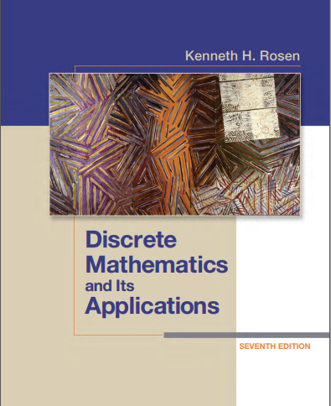

Discrete structures
By Dr. sajid iqbal
Course Reference Book

Slide 2
Nested quantifiers
Chapter - 1

Slide 3
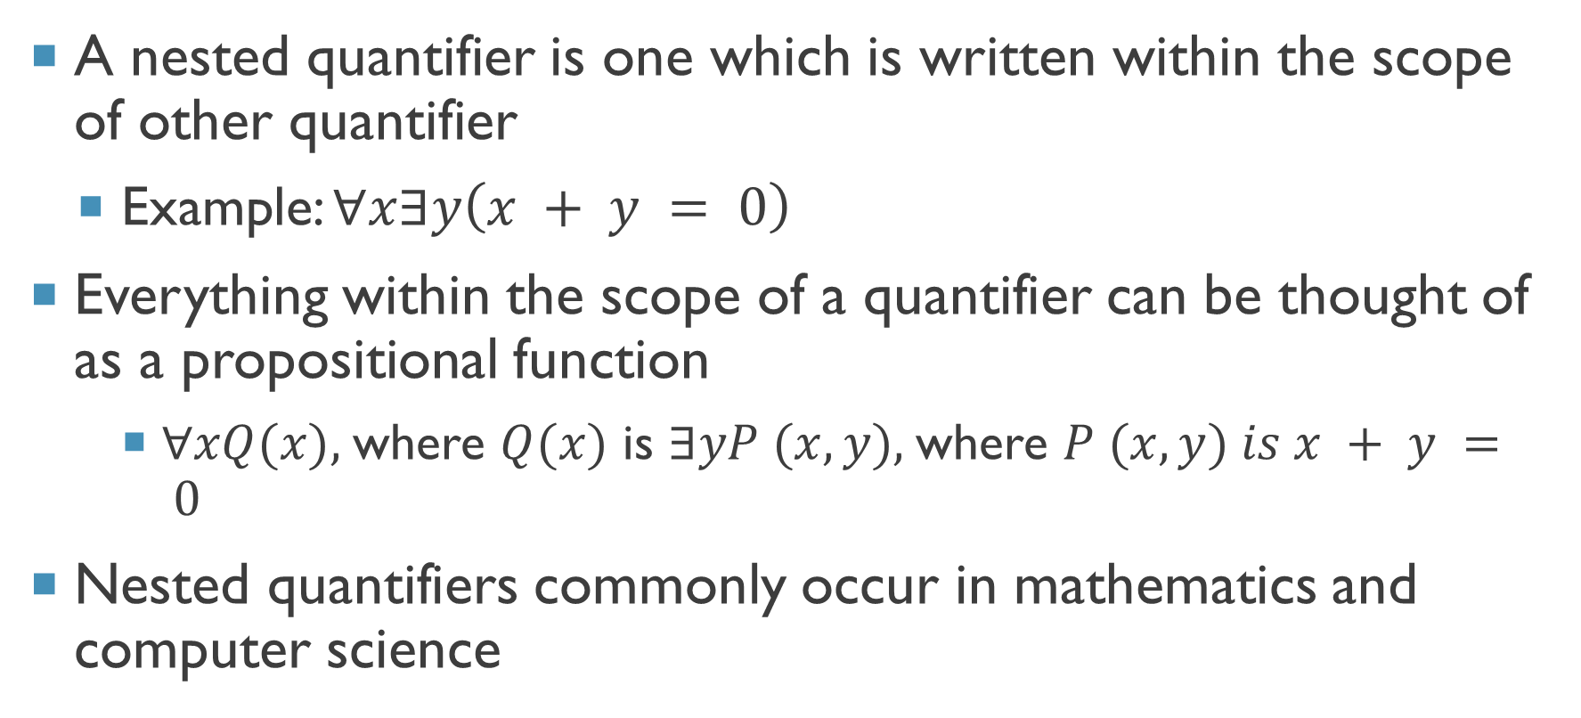
Background
A nested quantifier is one which is written within the scope of other quantifier
Example: $∀x∃y\left(x + y = 0\right)$
Everything within the scope of a quantifier can be thought of as a propositional function
$∀xQ(x),$where $Q(x)$ is $∃yP (x, y),$where $P (x, y) is x + y = 0$
Nested quantifiers commonly occur in mathematics and computer science

Slide 4
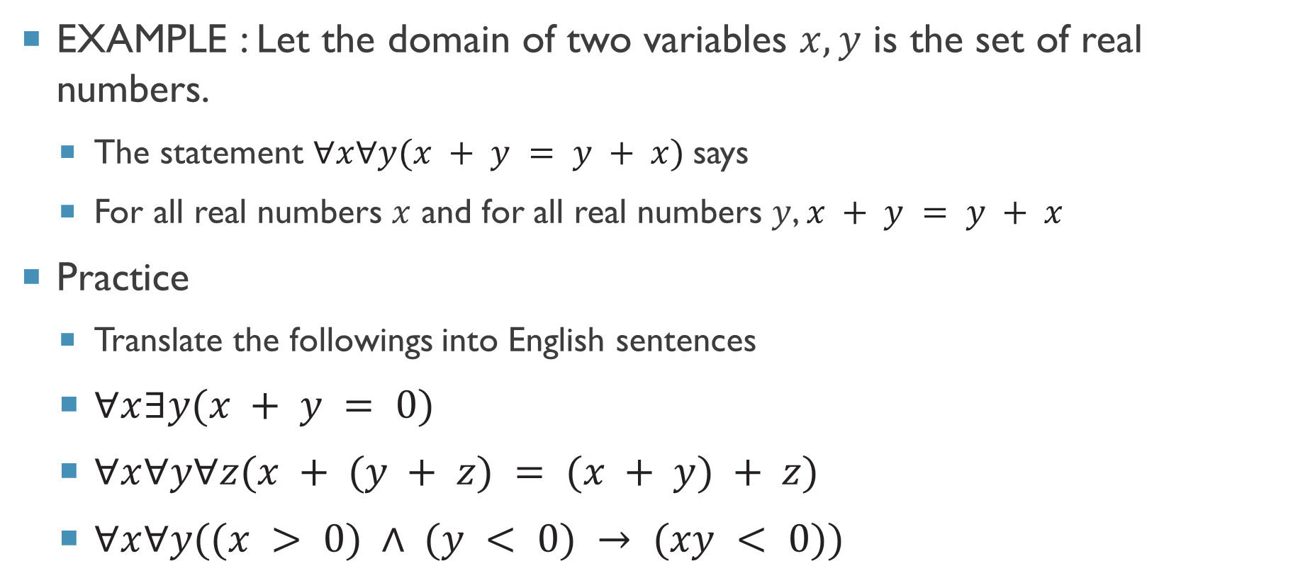
Nested quantifiers
EXAMPLE : Let the domain of two variables $x,y$ is the set of real numbers.
The statement $∀x∀y(x + y = y + x)$says
For all real numbers $x$ and for all real numbers $y$, $x + y = y + x$
Practice
Translate the followings into English sentences
$∀x∃y(x + y = 0)$
$∀x∀y∀z(x + (y + z) = (x + y) + z)$
$∀x∀y((x > 0) ∧ (y < 0) → (xy < 0))$

Slide 5
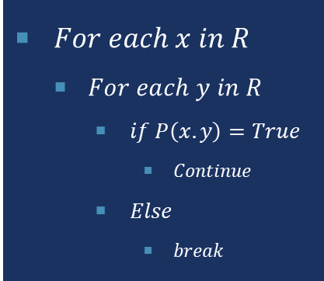
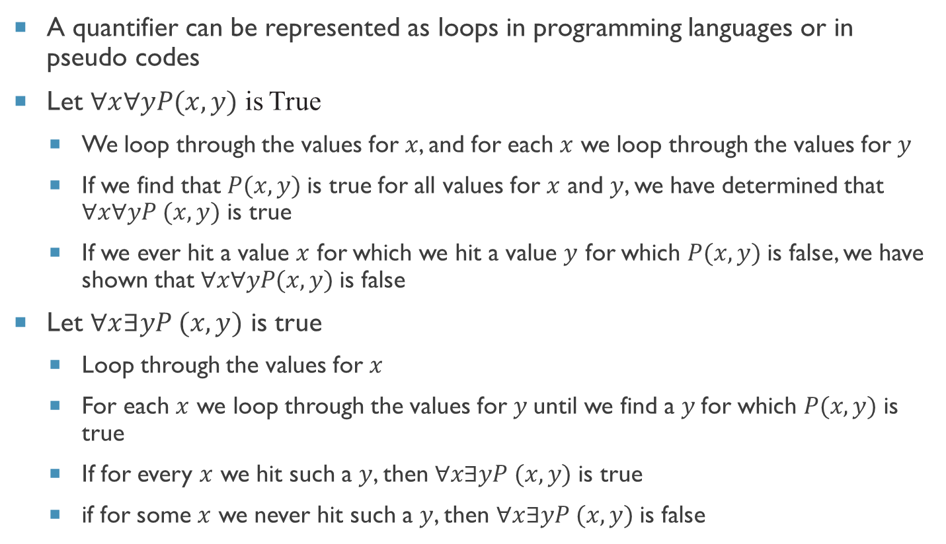
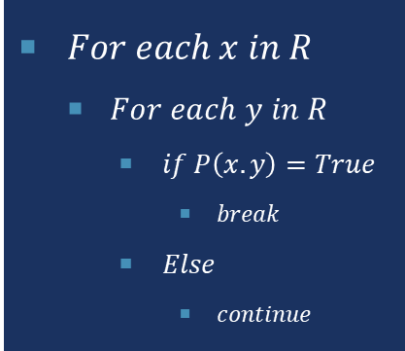
Quantifiers and programming loops
A quantifier can be represented as loops in programming languages or in pseudo codes
Let $∀x∀yP(x, y)$ is True
We loop through the values for $x$, and for each $x$ we loop through the values for $y$
If we find that $P(x, y)$is true for all values for $x$ and $y$, we have determined that $∀x∀yP (x, y)$ is true
If we ever hit a value $x$ for which we hit a value $y$ for which $P(x, y)$is false, we have shown that $∀x∀yP(x, y)$is false
Let $∀x∃yP (x, y)$ is true
Loop through the values for $x$
For each $x$ we loop through the values for $y$until we find a $y$for which $P(x, y)$is true
If for every $x$ we hit such a $y$, then $∀x∃yP (x, y)$is true
if for some $x$ we never hit such a $y$, then $∀x∃yP (x, y)$is false
$For each x in R$
$For each y in R$
$if P\left(x.y\right)=True$
$Continue$
$Else$
$break$
$For each x in R$
$For each y in R$
$if P\left(x.y\right)=True$
$break$
$Else$
$continue$

Slide 6
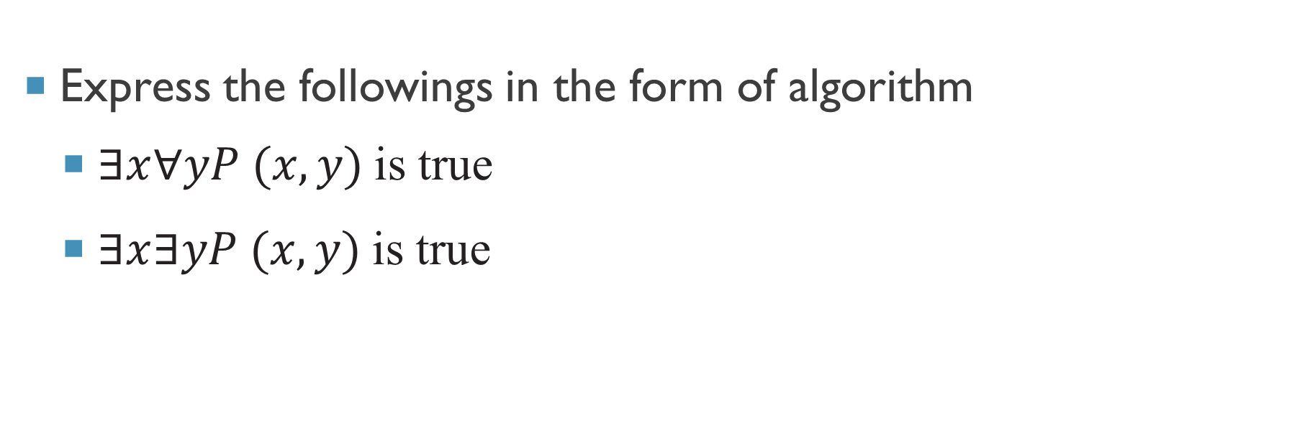
Practice problems
Express the followings in the form of algorithm
$∃x∀yP (x, y)$is true
$∃x∃yP (x, y)$is true

Slide 7
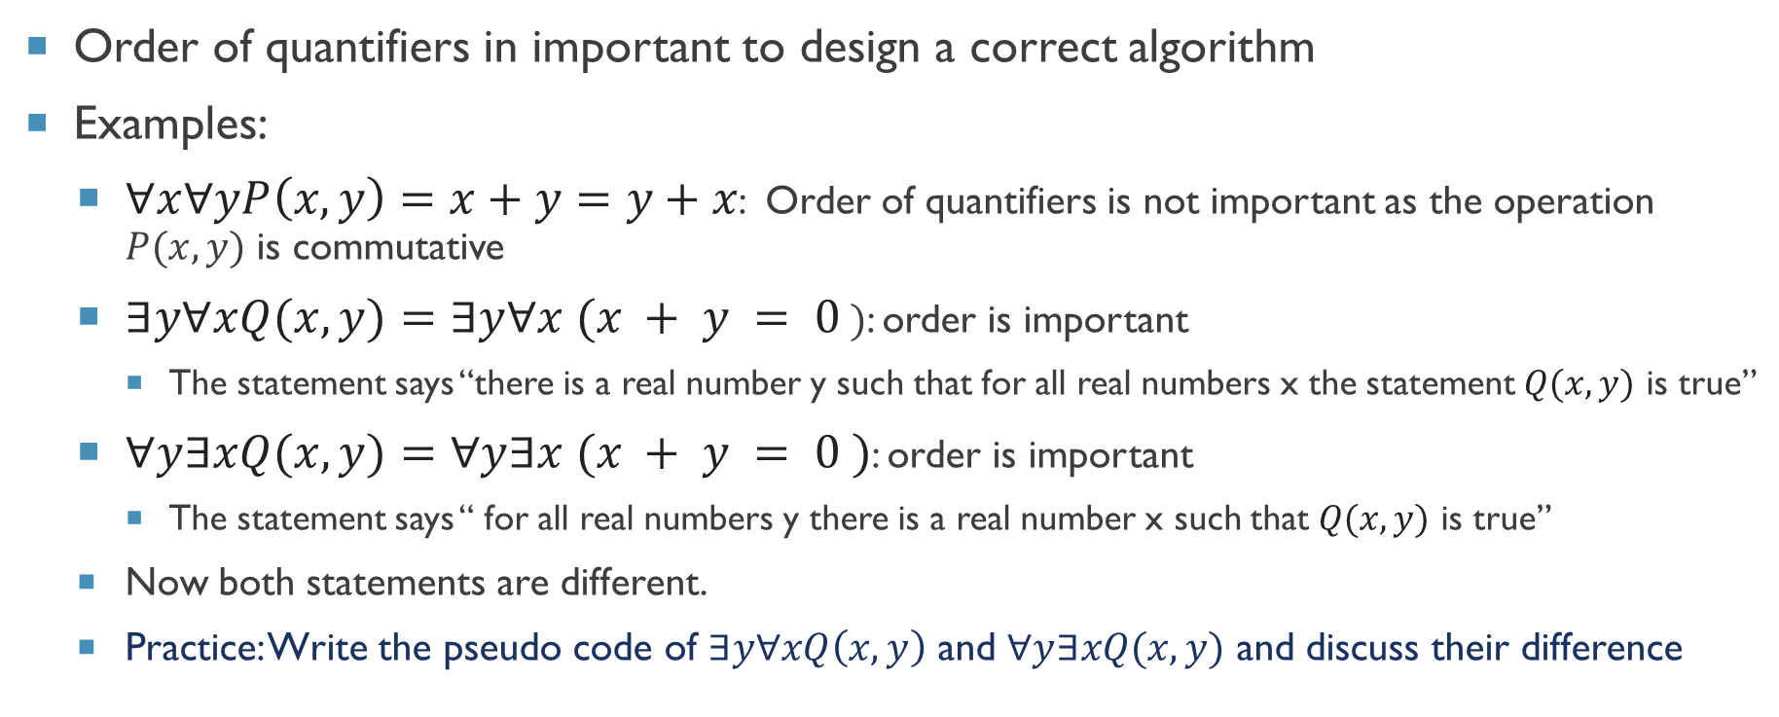
Order of quantifiers
Order of quantifiers in important to design a correct algorithm
Examples:
$∀x∀yP\left(x, y\right)=x+y=y+x$: Order of quantifiers is not important as the operation $P(x,y)$ is commutative
$∃y∀xQ(x, y)=∃y∀x (x + y = 0 )$: order is important
The statement says “there is a real number y such that for all real numbers x the statement $Q(x, y)$ is true”
$∀y∃xQ(x, y)=∀y∃x (x + y = 0 )$: order is important
The statement says “ for all real numbers y there is a real number x such that $Q(x, y)$ is true”
Now both statements are different.
Practice: Write the pseudo code of $∃y∀xQ\left(x, y\right)$ and $∀y∃xQ(x, y)$ and discuss their difference

Slide 8
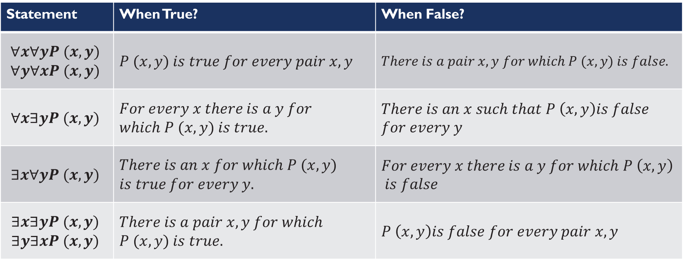
Quantification of two variables
Statement | When True? | When False?
$$∀x∀yP (x, y) \\ ∀y∀xP (x, y)$$ | $$P (x, y) is true for every pair x, y$$ | $$There is a pair x, y for which P (x, y) is false.$$
$$∀x∃yP (x, y)$$ | $$For every x there is a y for \\ which P (x, y) is true.$$ | $$There is an x such that P \left(x, y\right)is false$$ $$for every y$$
$$∃x∀yP (x, y)$$ | $$There is an x for which P (x, y) \\ is true for every y.$$ | $$For every x there is a y for which P \left(x, y\right)$$ $$is false$$
$$∃x∃yP (x, y) \\ ∃y∃xP (x, y)$$ | $$There is a pair x, y for which \\ P (x, y) is true.$$ | $$P \left(x, y\right)is false for every pair x, y$$

Slide 9
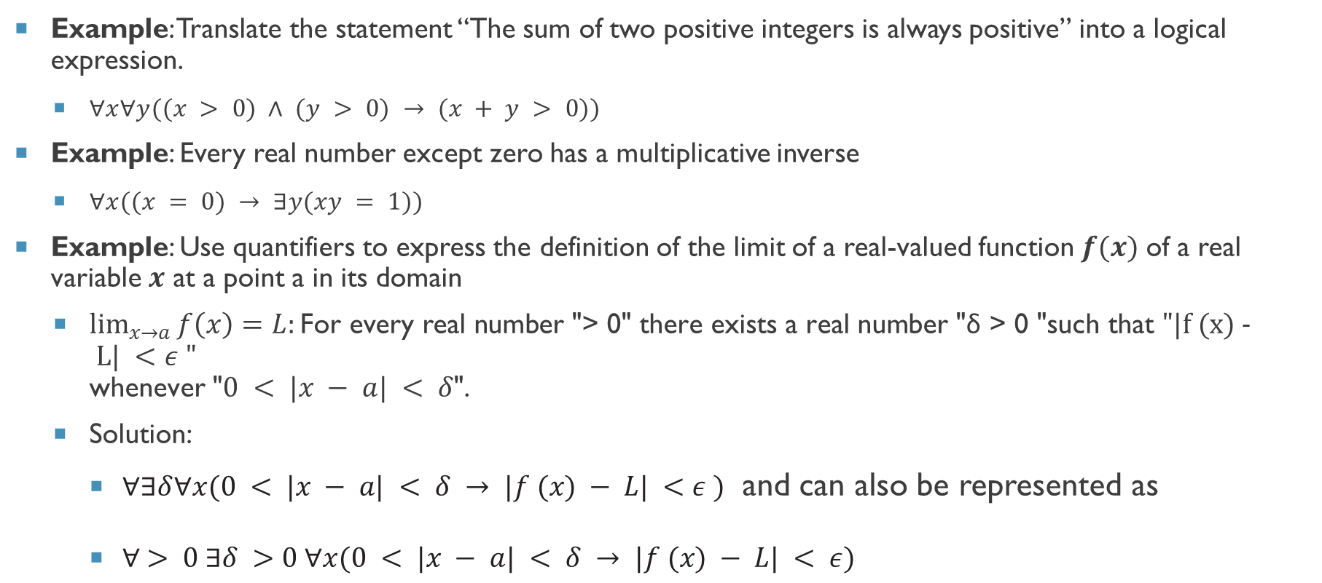
Mathematical statements to nested quantifiers
Example: Translate the statement “The sum of two positive integers is always positive” into a logical expression.
$∀x∀y((x > 0) ∧ (y > 0) → (x + y > 0))$
Example: Every real number except zero has a multiplicative inverse
$∀x((x = 0) → ∃y(xy = 1))$
Example: Use quantifiers to express the definition of the limit of a real-valued function $f(x)$ of a real variable $x$ at a point a in its domain
$\lim_{x→a}{f\left(x\right)=L:}\text{For} \text{every} \text{real} \text{number}$"> 0"$\text{there} \text{exists} \text{a} \text{real} \text{number}$"δ > 0 "$\text{such} \text{that} "|f (x) - L| <ε "$ $\text{whenever}$"$0 < |x − a| < δ$"$\text{. }$
Solution:
$∀∃δ∀x(0 < |x − a| < δ → |f (x) − L| <ε )$ and can also be represented as
$∀ > 0 ∃δ >0 ∀x(0 < |x − a| < δ → |f (x) − L| < ε)$

Slide 10
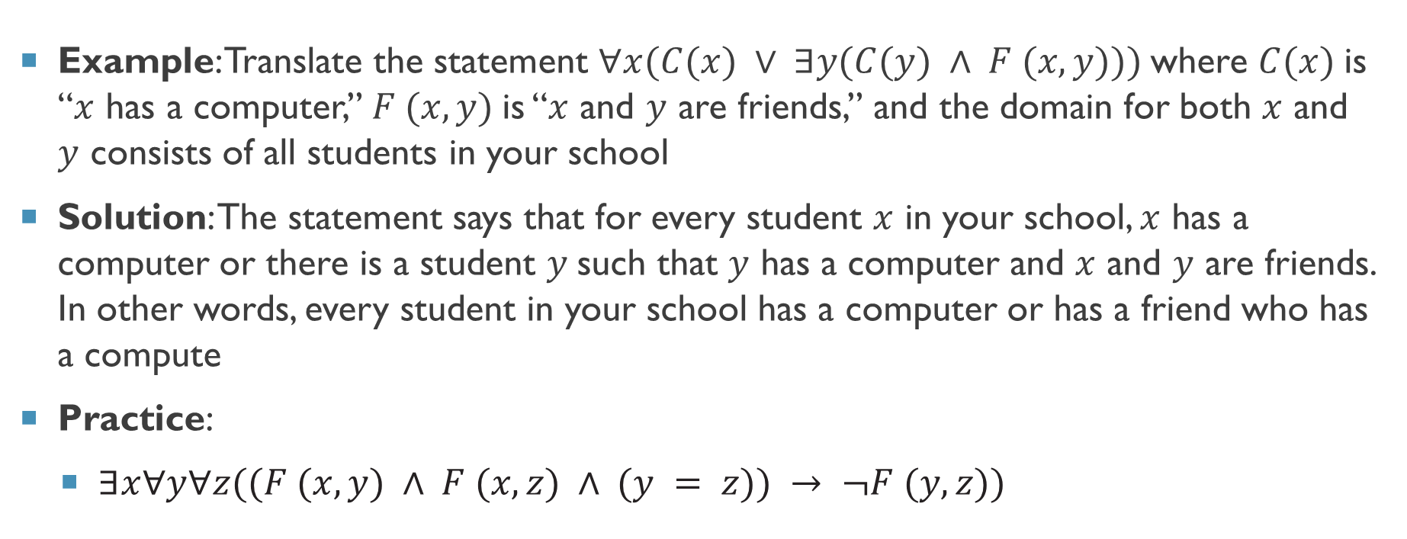
Nested quantifiers to English
Example: Translate the statement $∀x(C(x) ∨ ∃y(C(y) ∧ F (x, y)))$where $C(x)$is “$x$ has a computer,” $F (x, y)$is “$x$ and $y$ are friends,” and the domain for both $x$ and $y$ consists of all students in your school
Solution: The statement says that for every student $x$ in your school, $x$ has a computer or there is a student $y$such that $y$ has a computer and $x$ and $y$ are friends. In other words, every student in your school has a computer or has a friend who has a compute
Practice:
$∃x∀y∀z((F (x, y) ∧ F (x, z) ∧ (y = z)) → ¬F (y,z))$

Slide 11
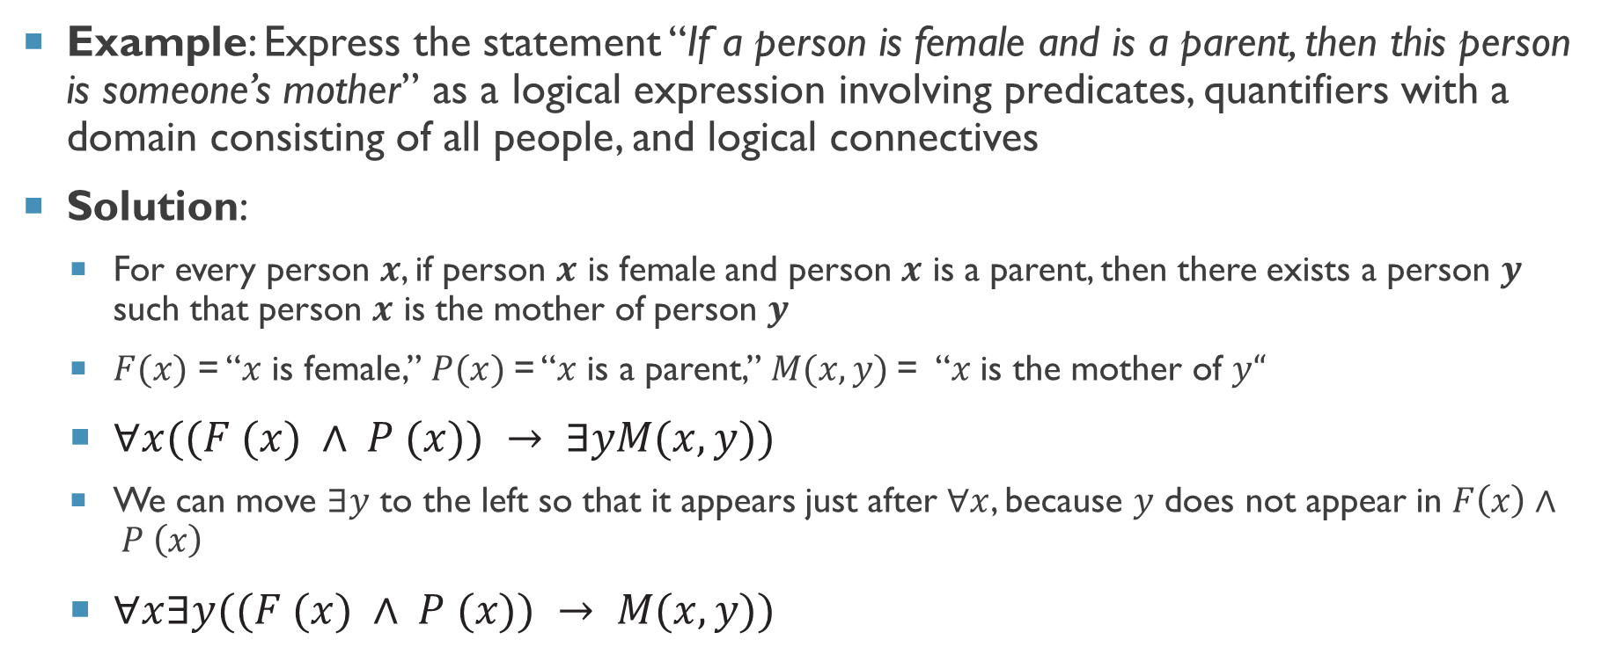
English sentence to logical expression
Example: Express the statement “If a person is female and is a parent, then this person is someone’s mother” as a logical expression involving predicates, quantifiers with a domain consisting of all people, and logical connectives
Solution:
For every person $x$, if person $x$ is female and person $x$ is a parent, then there exists a person $y$ such that person $x$ is the mother of person $y$
$F(x)$ = “$x$ is female,” $P(x)$= “$x$ is a parent,” $M(x, y)$= “$x$ is the mother of $y“$
$∀x((F (x) ∧ P (x)) → ∃yM(x, y))$
We can move $∃y$ to the left so that it appears just after $∀x$, because $y$ does not appear in $F\left(x\right)∧ P \left(x\right)$
$∀x∃y((F (x) ∧ P (x)) → M(x, y))$

Slide 12
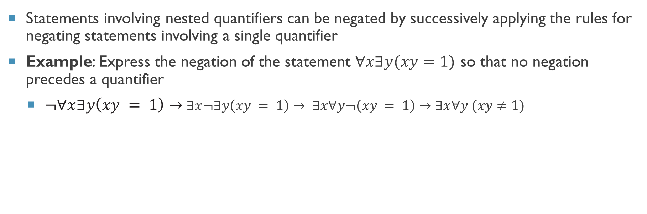
Negating nested quantifiers
Statements involving nested quantifiers can be negated by successively applying the rules for negating statements involving a single quantifier
Example: Express the negation of the statement $∀x∃y(xy=1)$ so that no negation precedes a quantifier
$¬∀x∃y\left(xy = 1\right)→$ $∃x¬∃y\left(xy = 1\right)→ ∃x∀y¬\left(xy = 1\right)→∃x∀y (xy≠1)$

Slide 13



Thanks for watching
Dr. Sajid Iqbal
Assistant Professor
Department of Computer Science
Bahauddin Zakariya University, Multan
sajidiqbal.pk@gmail.com
https://github.com/sajjo79/DiscreteMathematics
Allah Hafiz
COMEDXD

